Slide 1
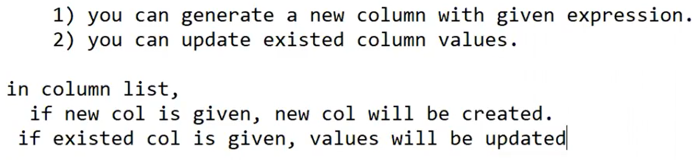

Slide 2
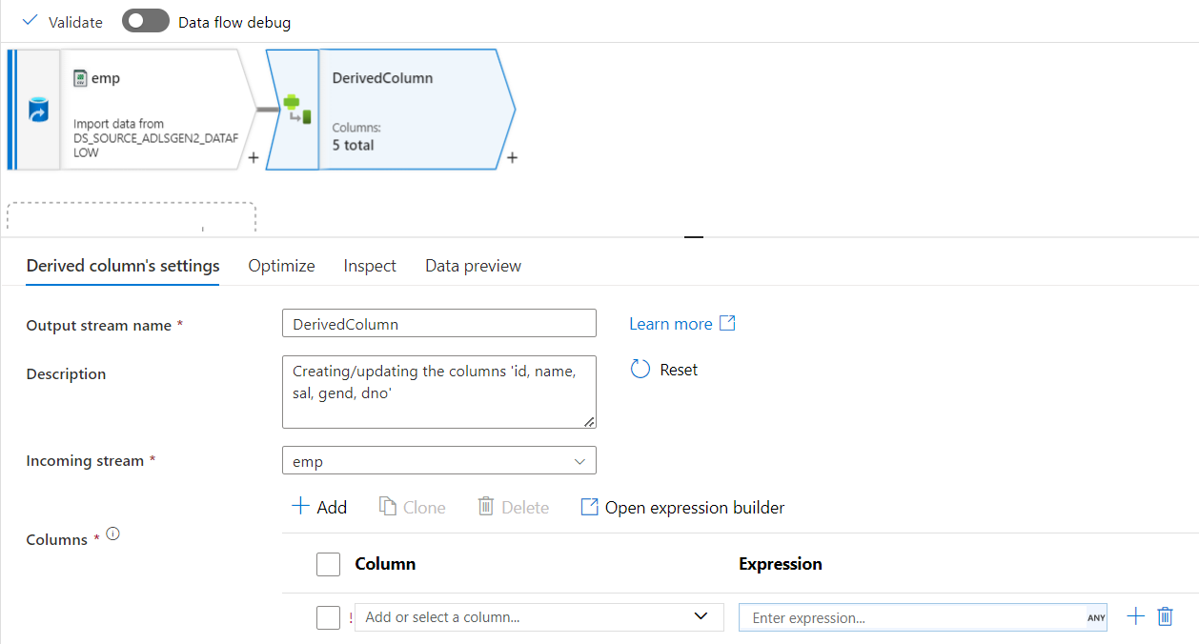

Slide 3
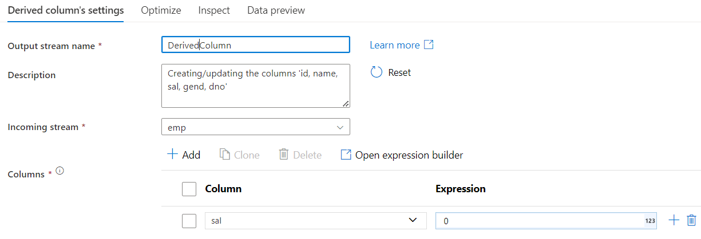
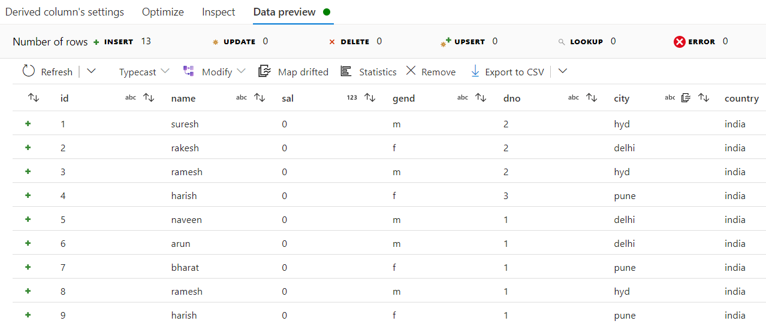

It will replace entire column of sal to 0

Slide 4
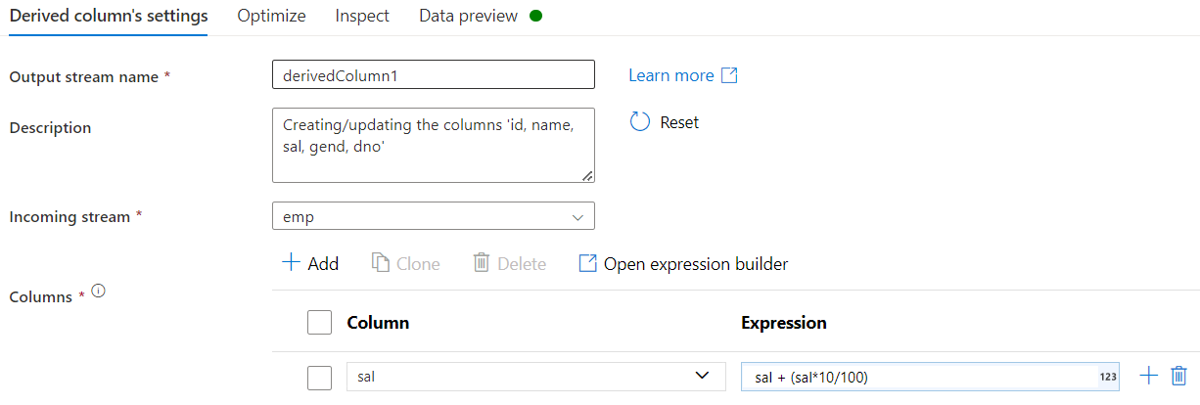
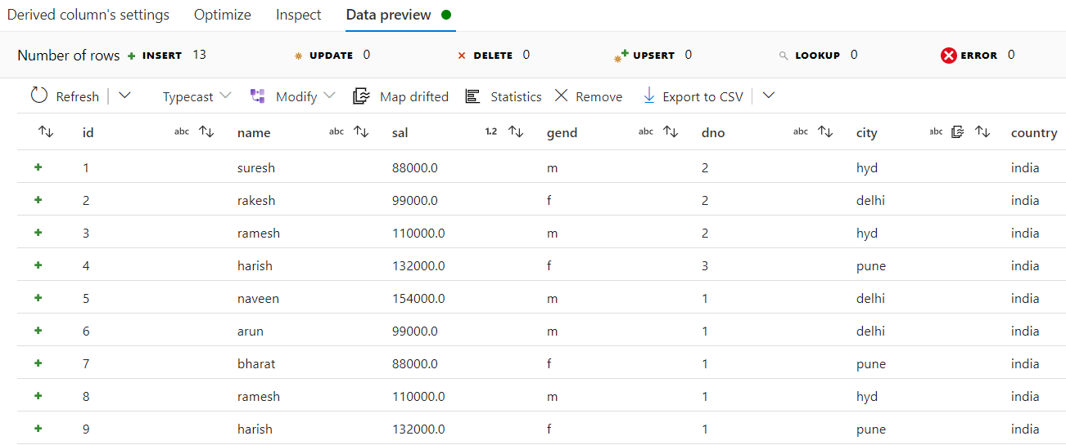
It will replace entire column of sal with this logic
sal
Sal+(sal*10/100)

Slide 5
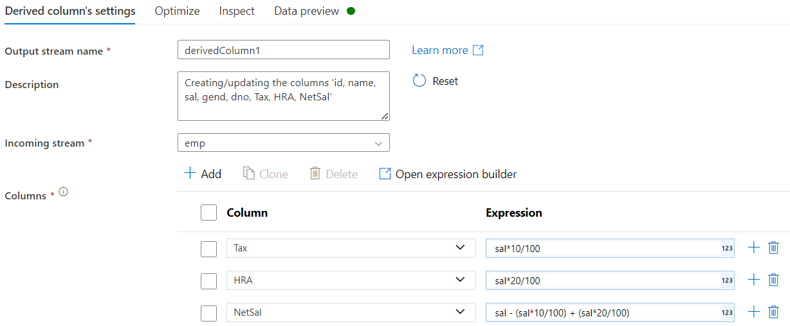
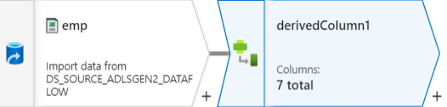
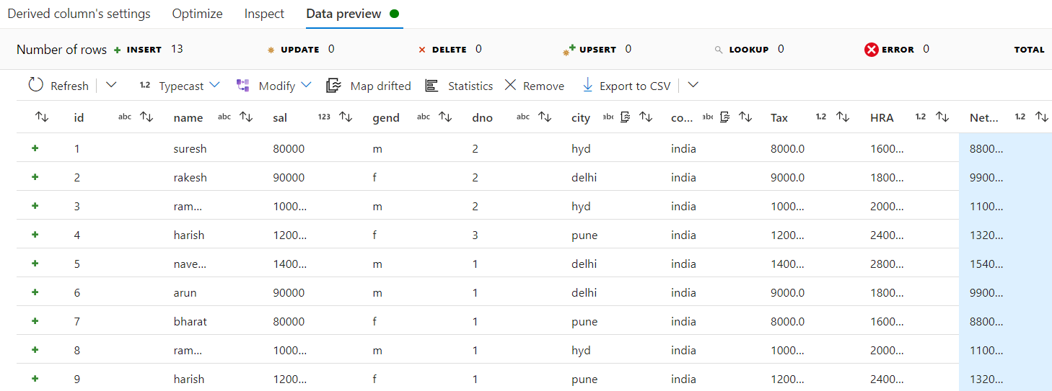
Method 01
It will add 3 new columns: Tax, HRA & NetSal
Tax
sal+(sal*10/100)
HRA
sal+(sal*20/100)
NetSal
sal - (sal*10/100) + (sal*20/100)

Slide 6
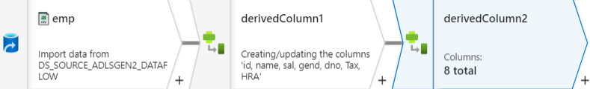
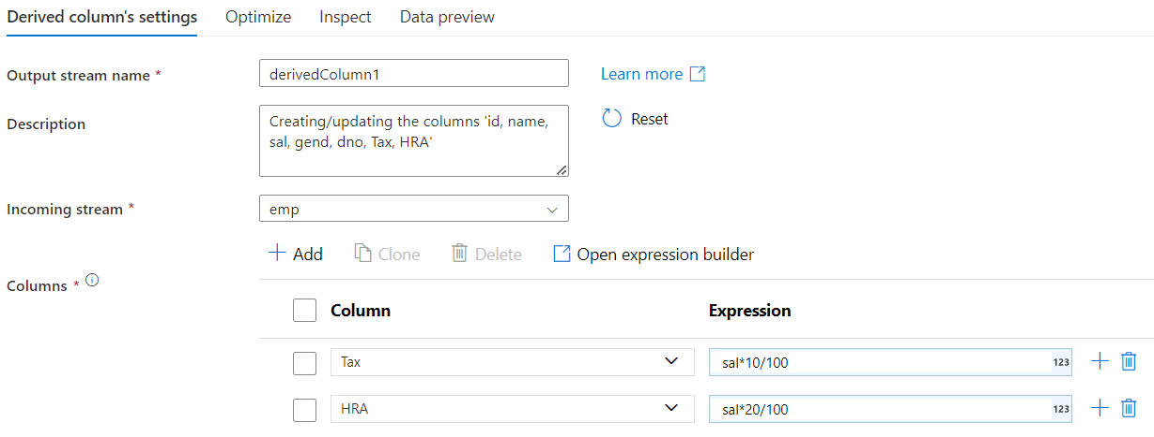
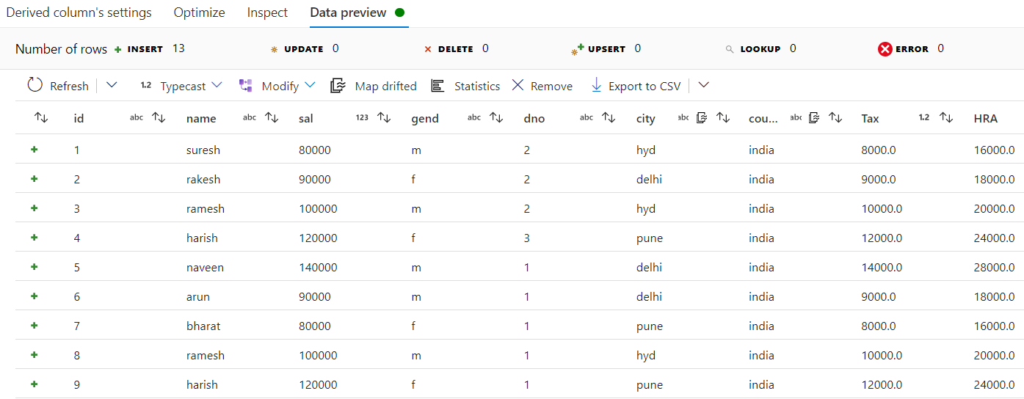
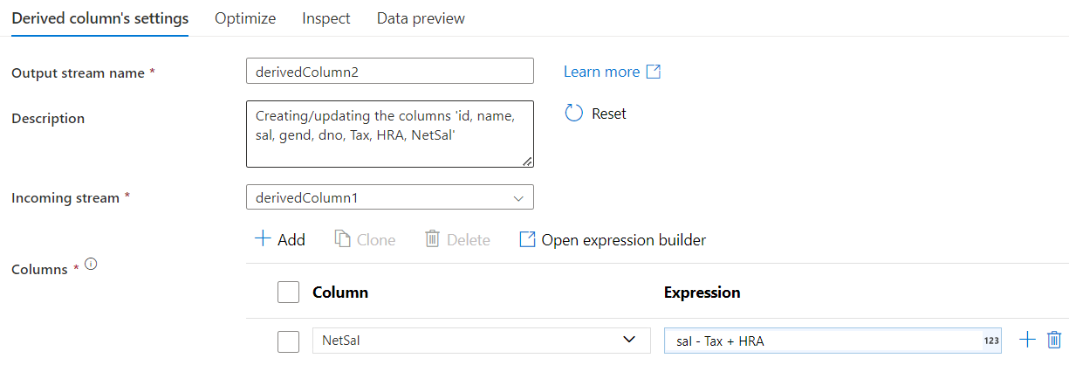
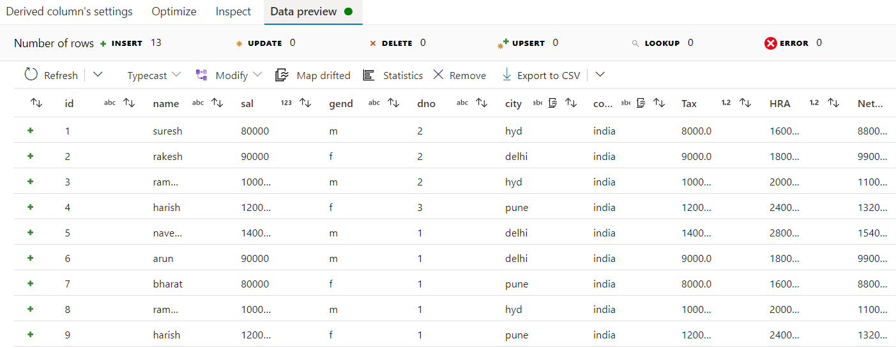
Method 02
It will add 2 new columns: Tax, HRA
Tax
sal+(sal*10/100)
HRA
sal+(sal*20/100)
It will add 1 new column: NetSal
NetSal
sal – Tax + HRA

Slide 7
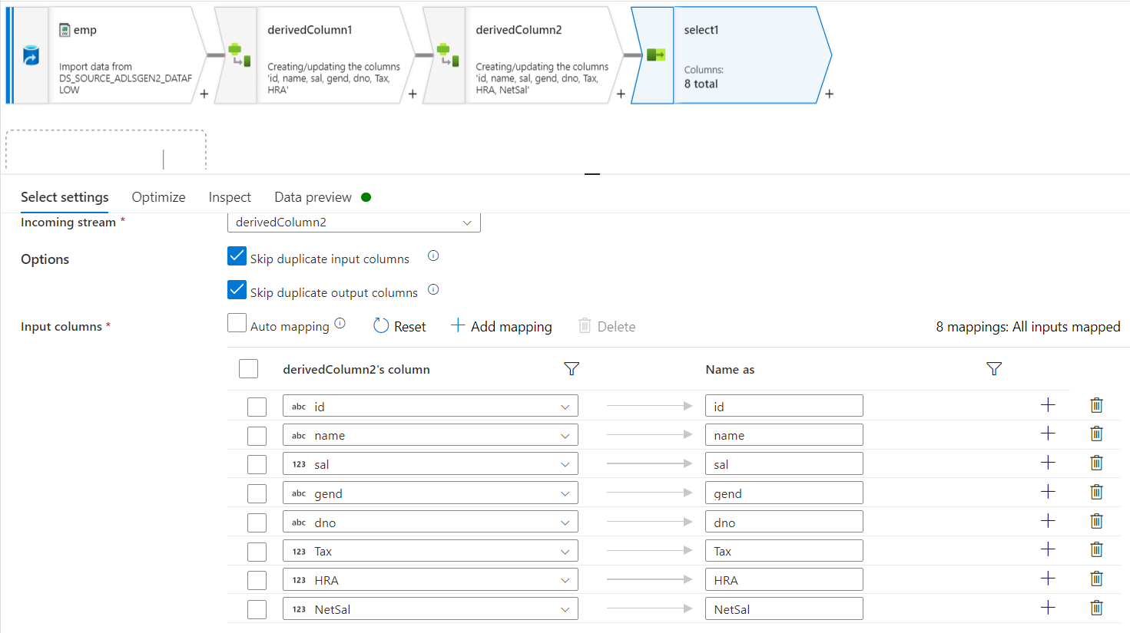
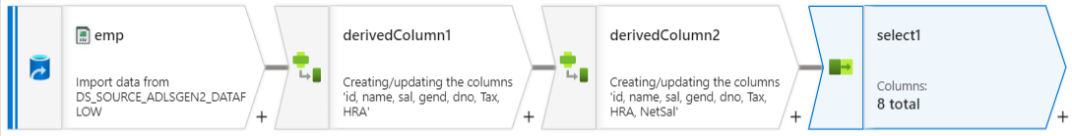
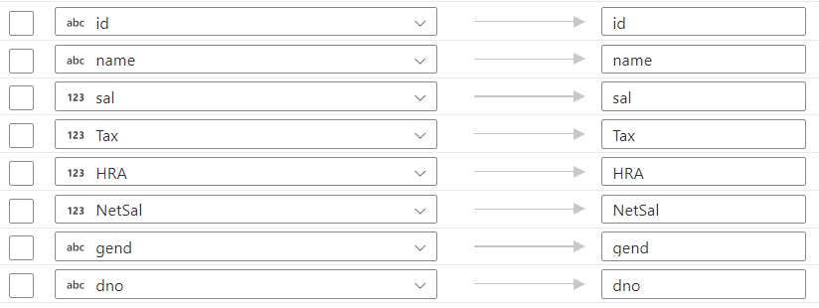
Reorder Columns

Slide 8
